Slide 1
Flare
Nassir Ali, Safi Hasani, Maria Mancz, Ailyn Tyagi
Senior Design at NYU Tandon - Spring 2021

Slide 2

Our Team
Nassir Ali
Testing
Cloud Deployment
Back-End

Slide 3

Our Team
Safi Hasani
API Integration
Back-End

Slide 4

Our Team
Maria Mancz
Cloud Deployment
UML Diagramming

Slide 5

Our Team
Ailyn Tyagi
UI/UX Design
Front-End
Back-End

Slide 6
Problem Overview
As more Social Networking Sites emerge, it is hard for a user to keep track of all of their social handles.
When meeting new people, a user might want to connect with them on more than one Social Networking Site.
This repetitive task can be tiring, and even awkward.
The solution? A site to link all of their accounts.

Slide 7

Flare

Slide 8
Application Demo
(register, log in, add site)

Slide 9
Process
Frontend Team (HTML, CSS, Jinja)
User Interface Design
User Experience Design
Quality Assurance
Backend Team (Python, SQLite)
User and Social Accounts Database
Flare API
External Social Media APIs
Testing

Slide 10
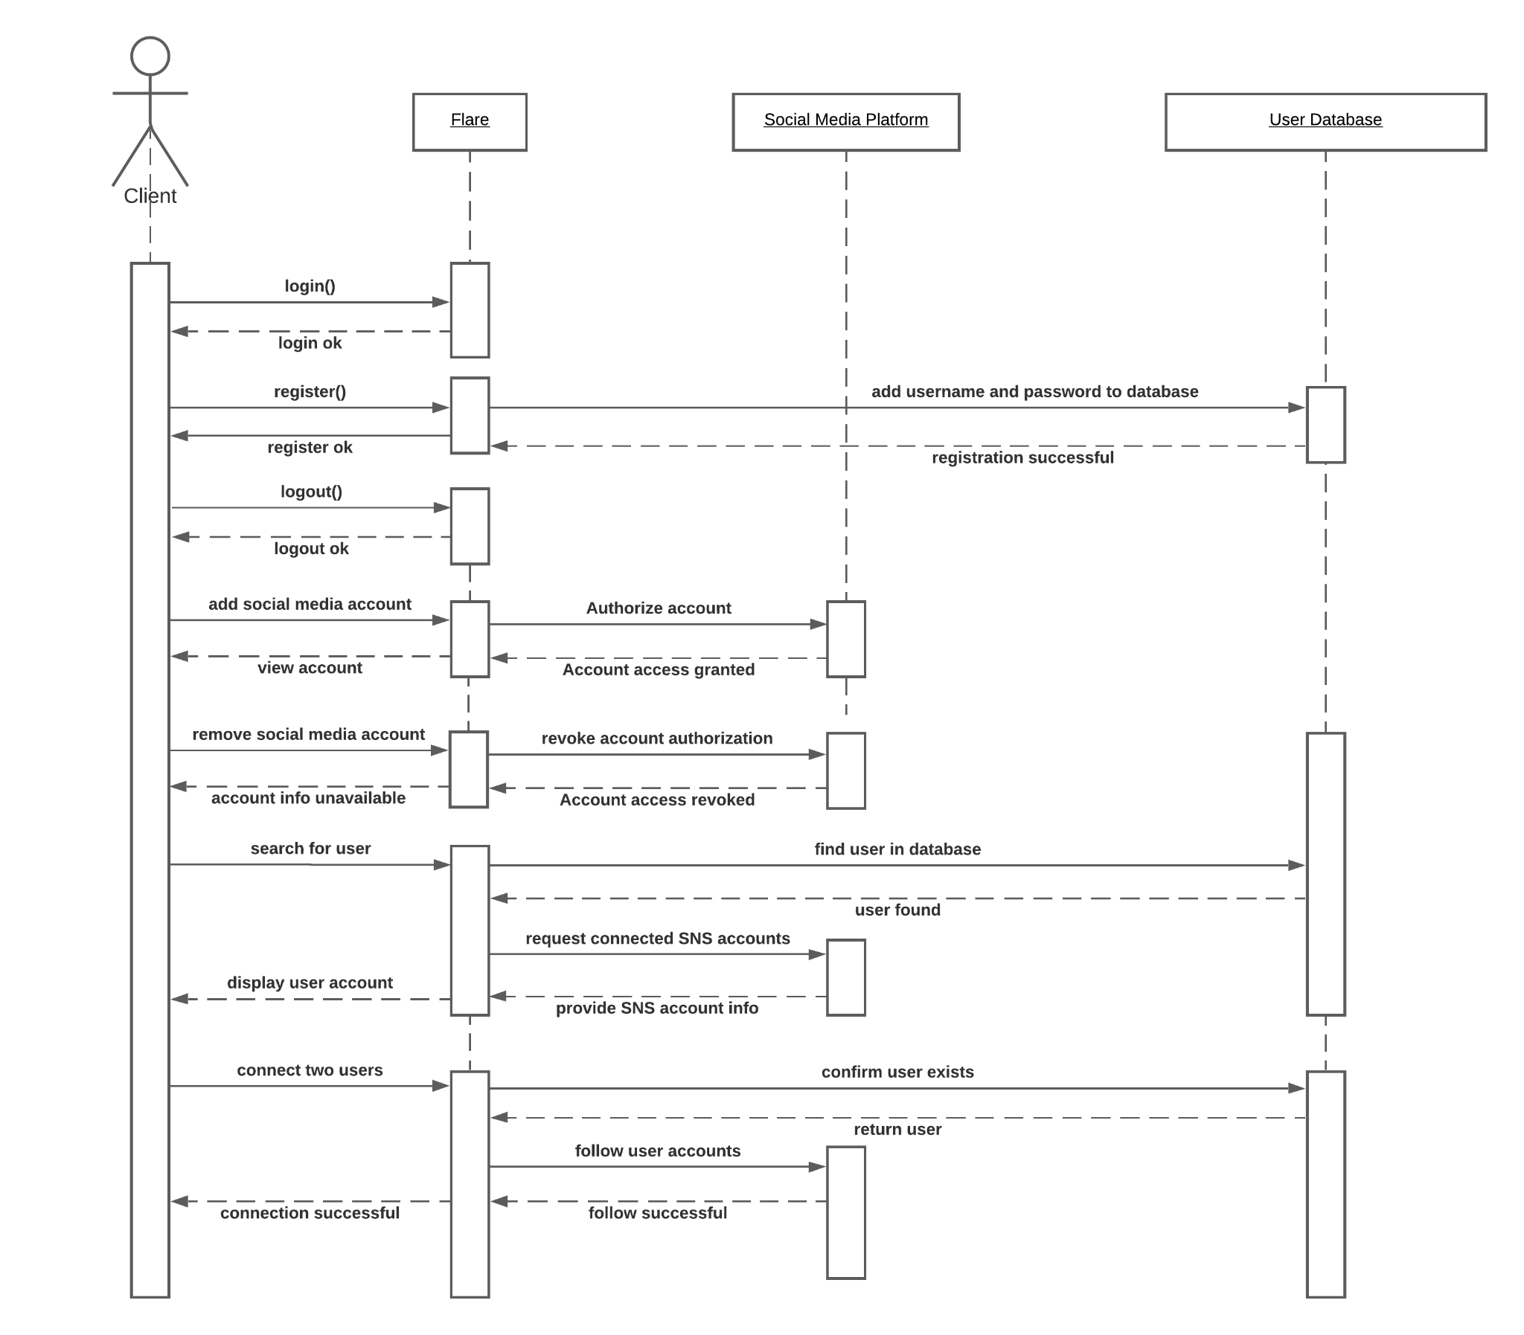
Sequence Diagram

Slide 11
Sequence Diagram (con’t)

Slide 12



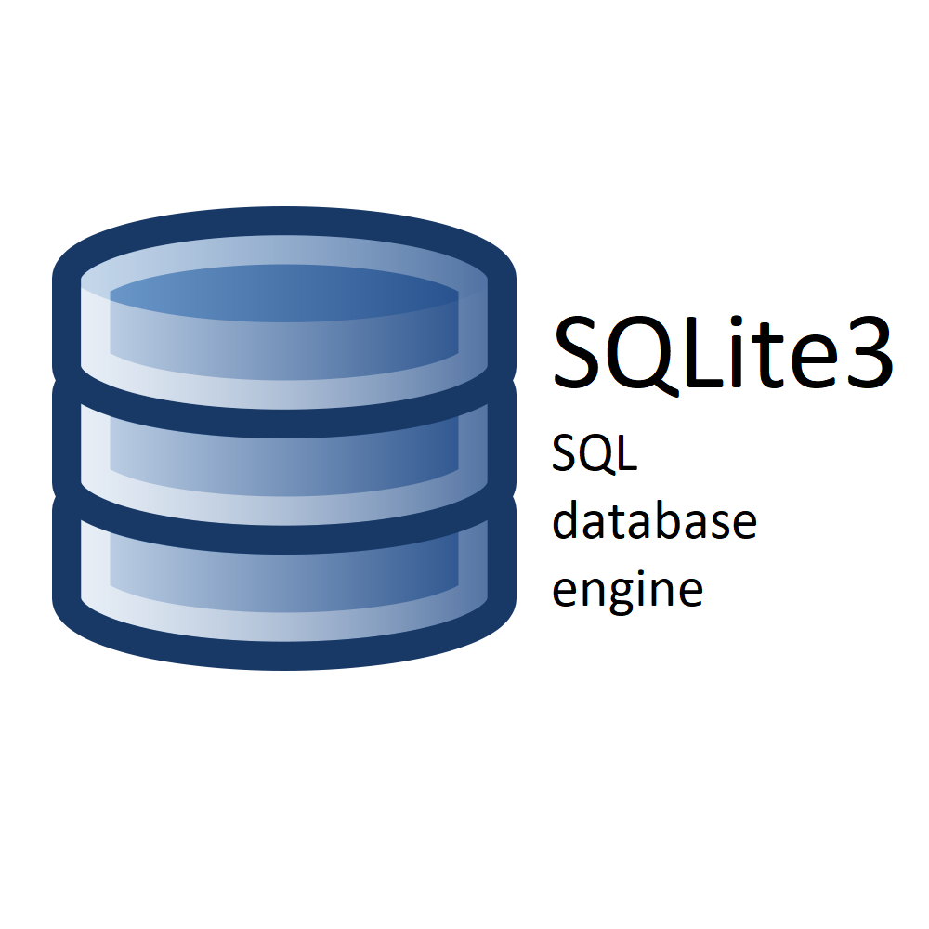


Tech Stack

Slide 13
Testing
Testing done using:
Pytest - Run the tests
Pytest-cov - View the test coverage and make a coverage file
Codecov - View the coverage in-depth
All in conjunction with Travis CI - Build and test version control
Pytest is the main testing plugin, Codecov is the main coverage report plugin
Pytest-cov and codecov, provide coverage reports
Currently at 86% total coverage
https://codecov.io/github/suh-fee/teamA34DesignProj/commit/9417bc4f143c32e0c4429cd24c0dec56ec6365f0

Slide 14
Cloud Deployment
Cloud deployment done via Heroku
Successful Travis builds are deployed through Heroku
Build and run the app from Heroku

Slide 15

API Integration
Twitter API Integration as a baseline for future features
Uses the Tweepy python module to connect to the Twitter API
https://www.tweepy.org/
Supports per-user authentication in order to follow any Flare user’s Twitter account with one button press

Slide 16
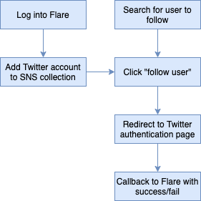
Tweepy
Handles direct calls to Twitter’s API
Allows for easy back-end authentication management
Integrates well with Flask
Uses Flask server-side session management to hold success/fail case

Slide 17
Tweepy Authentication Demo and Explanation

Slide 18
What to Add Next
Facebook API
Login to Flare using Facebook credentials
Connect Facebook and Instagram pages
https://facebook-sdk.readthedocs.io/en/latest/index.html
Linkedin API
Directly connect to Linkedin accounts through Flare
https://pypi.org/project/python3-linkedin/
Python ‘Requests’ Library
File upload/download over HTTP
To allow for direct Resume uploading
Better API Key management

Slide 19
Post-Mortem
Automated testing can be difficult across different development environments
Essential to track Session Tokens and Information across multiple page redirects
Codecov provides detailed line by line analysis of covered lines via testing
Python paths can be tricky to deal with
Important to have good database design and properly establish the relation between different tables
Standardization of cross-platform development

Slide 20

Contact us for questions.
Nassir Ali: nassir.ali@nyu.edu
Safi Hasani: safihasani@nyu.edu
Maria Mancz: mm8348@nyu.edu
Ailyn Tyagi: atm467@nyu.edu

Slide 21
Video Recording
https://nyu.zoom.us/rec/share/qczNY7r9Zfqox1jKUTe2WcVh_T5Umv56GezvRqv96qZXnY_V0XhI8dKkvWDHXgai.6Xb_ongXLloicbTI?startTime=1620683091000

